Slide 1
EE-608 Project: GANs
Aryan Garg

Slide 2
Goals:
Paper Replication Skill
Reach a comfortable yet efficient framework (+ experiment tracker) for end-to-end ML solutions
Use image processing techniques to experiment over well-known GANs
Make even more professional reports faster (overleaf)

Slide 3
Papers Replicated (over datasets):
GAN - FahsionMNIST
WGAN - FashionMNIST
WGAN-GP - FashionMNIST
DCGAN + StyleGAN - AFHQ (Dog Subset)
SRGAN - Kaggle SR Dataset
infoGAN - MNIST
realnessGAN - MNIST
cycleGAN - Monet Art Dataset
Pix2pix - Facades

Slide 4
GAN (Ian Goodfellow; 2014)
Implicit density from which direct sampling is done unlike Belief Nets, VAEs, HMMs and Boltzmann machines that explicitly encode the data distribution
Based on the mini-max games (and Nash equilibrium)
Architecture:
2 Adversarial Networks Competing on the same BCE-objective (Discriminator & Generator)
Both are fully connected MLP Layers

Slide 5
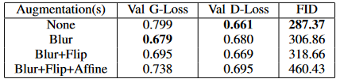
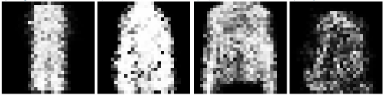
GAN - Results on FashionMNIST

Slide 6
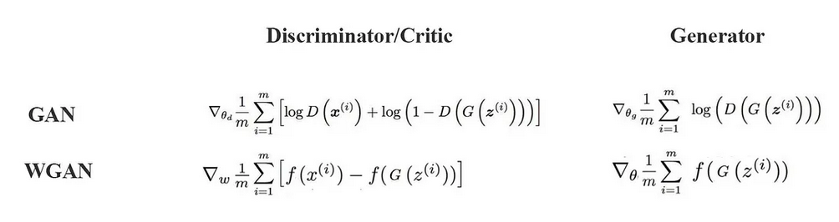
WGAN
BCE → log function unstable with large variance of gradients
Wasserstein Distance alternative to BCE:
Source: WGAN-Medium
Additional Changes:
Optimizer: RMSProp
Weight Clipping to ensure 1-Lipshitz continuity

Slide 7
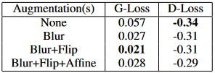
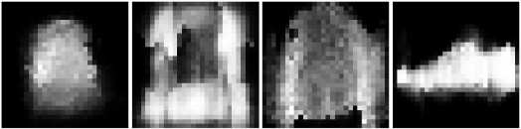
WGAN - Results on FashionMNIST

Slide 8
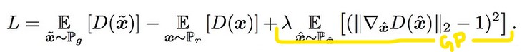
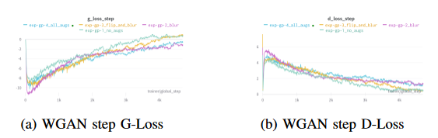
WGAN-GP
Instead of applying clipping, WGAN-GP penalizes the model if the gradient norm moves away from its target norm value 1.
Better loss progression observed:

Slide 9
DCGAN + StyleGAN
VAL, IISc Project Associate Position Assignment
Experiments:
DCGAN - basic sanity runs & hyperparameter tuning
Infusing StyleGAN’s Adaptive Instance Normalization Layers for style guided outputs & a Mapping Network (for disentanglement)
Z & W-space interpolation
Spectrally Normalized Discriminator
*All results in subsequent slides are from the report submitted at VAL

Slide 10
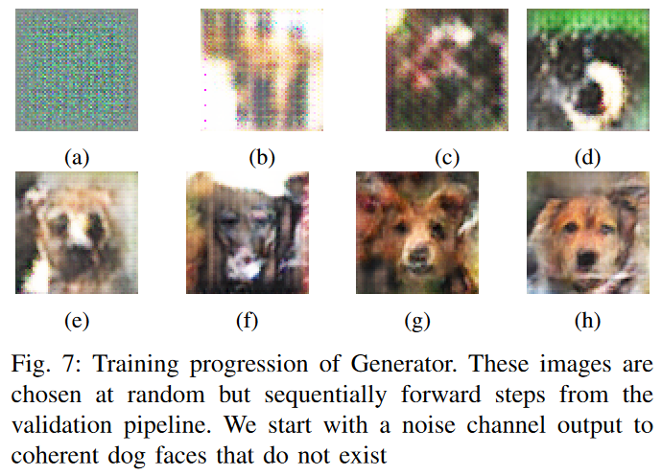
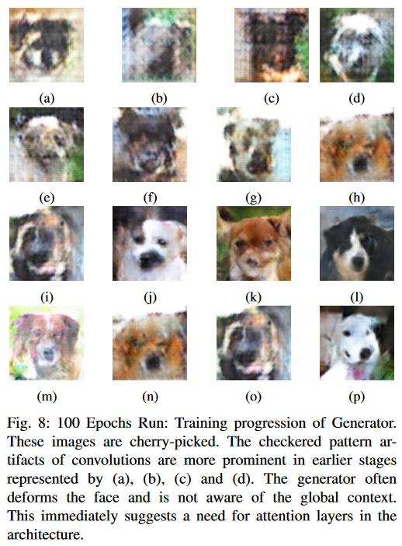
DCGAN-StyleGAN - Results of Experiment a (1/5)

Slide 11
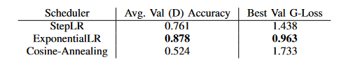
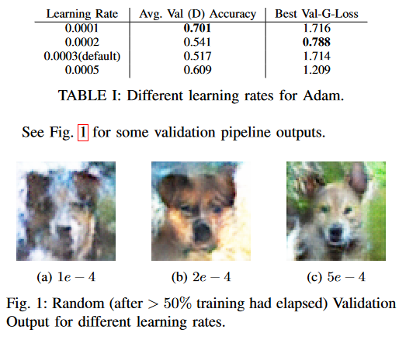
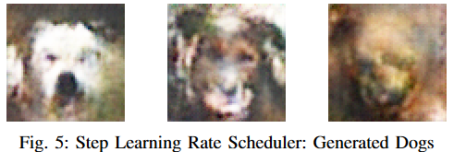
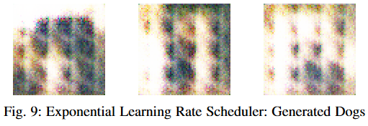
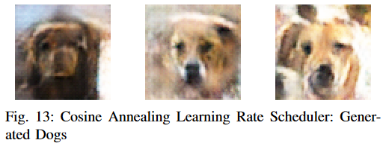
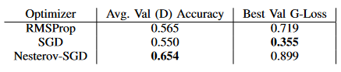
DCGAN-StyleGAN - Results of Experiment a (2/5)

Slide 12
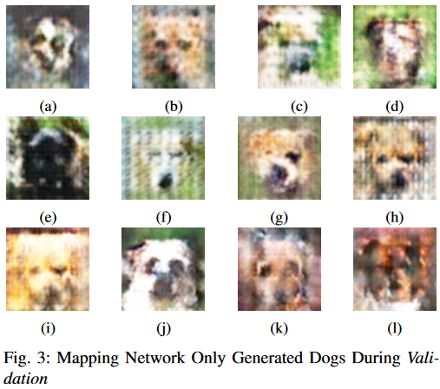
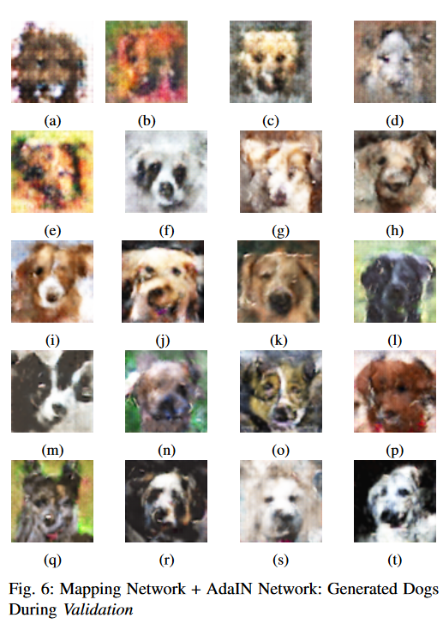
DCGAN-StyleGAN - Results of Experiment b (3/5)

Slide 13
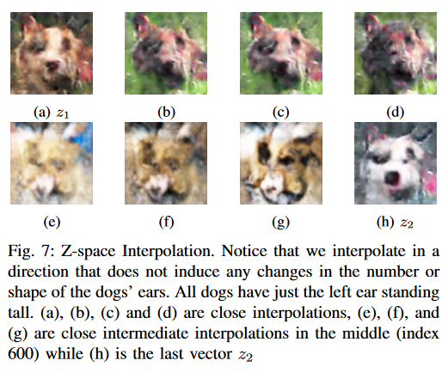
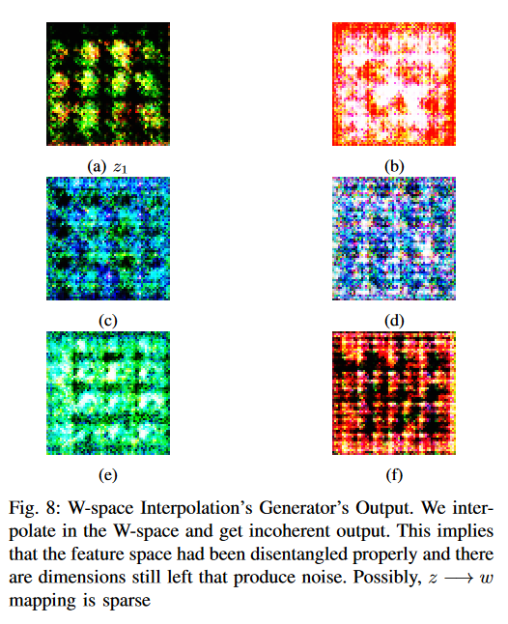
DCGAN-StyleGAN - Results of Experiment c (4/5)

Slide 14
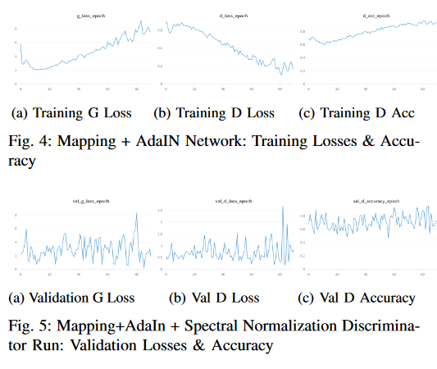
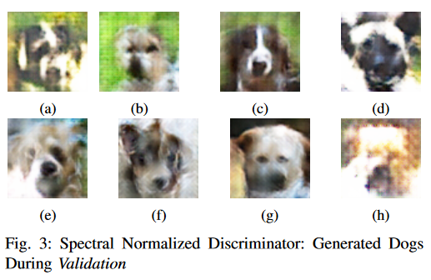
DCGAN-StyleGAN - Results of Experiment d (5/5)

Slide 15
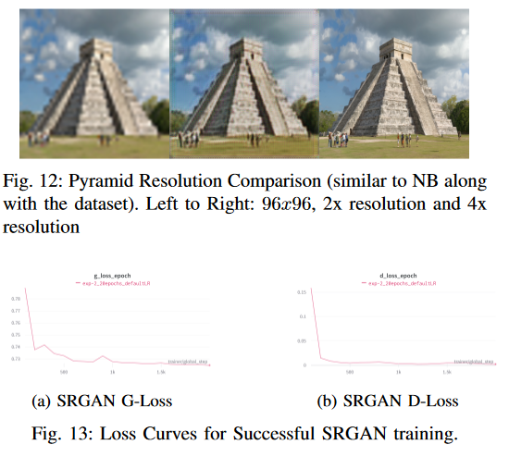
SRGAN
Uses a content loss motivated by perceptual similarity (VGG based).
The network consists of residual blocks.

Slide 16
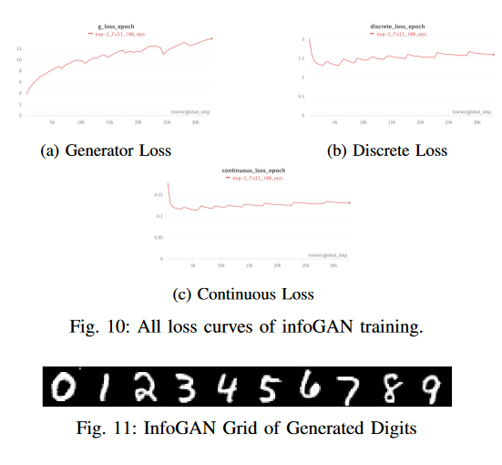
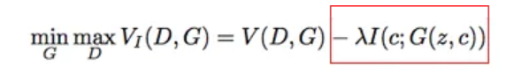
infoGAN
Uses information theoretic variational regularization to maximise the mutual information between latent codes (c: additional input to G) and the generator output.
Uses a lower bound to calculate I(c, G(z,c))
Arch: Additional Q-network after D
Source: From the report itself

Slide 17
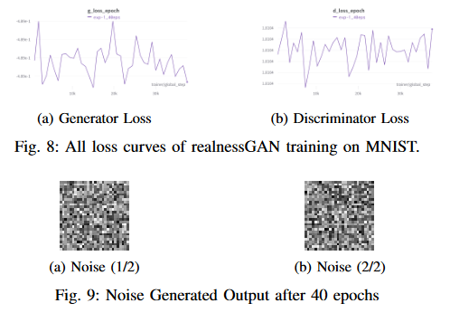

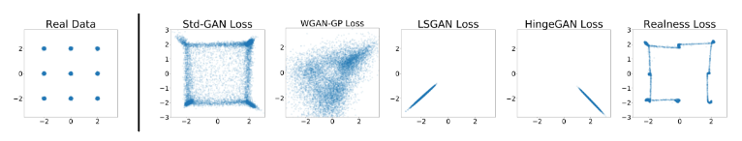
Realness GAN - Failed Training → Anchors too close?
The discriminator outputs a distribution as the measure of realness. RealnessGAN is a generalized version of the original GAN.
Provides stronger guidance for the generator → How? Ans: KLD with Anchors.

Slide 18
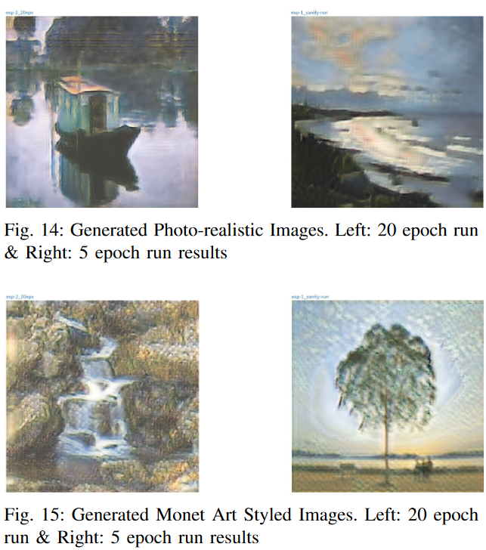

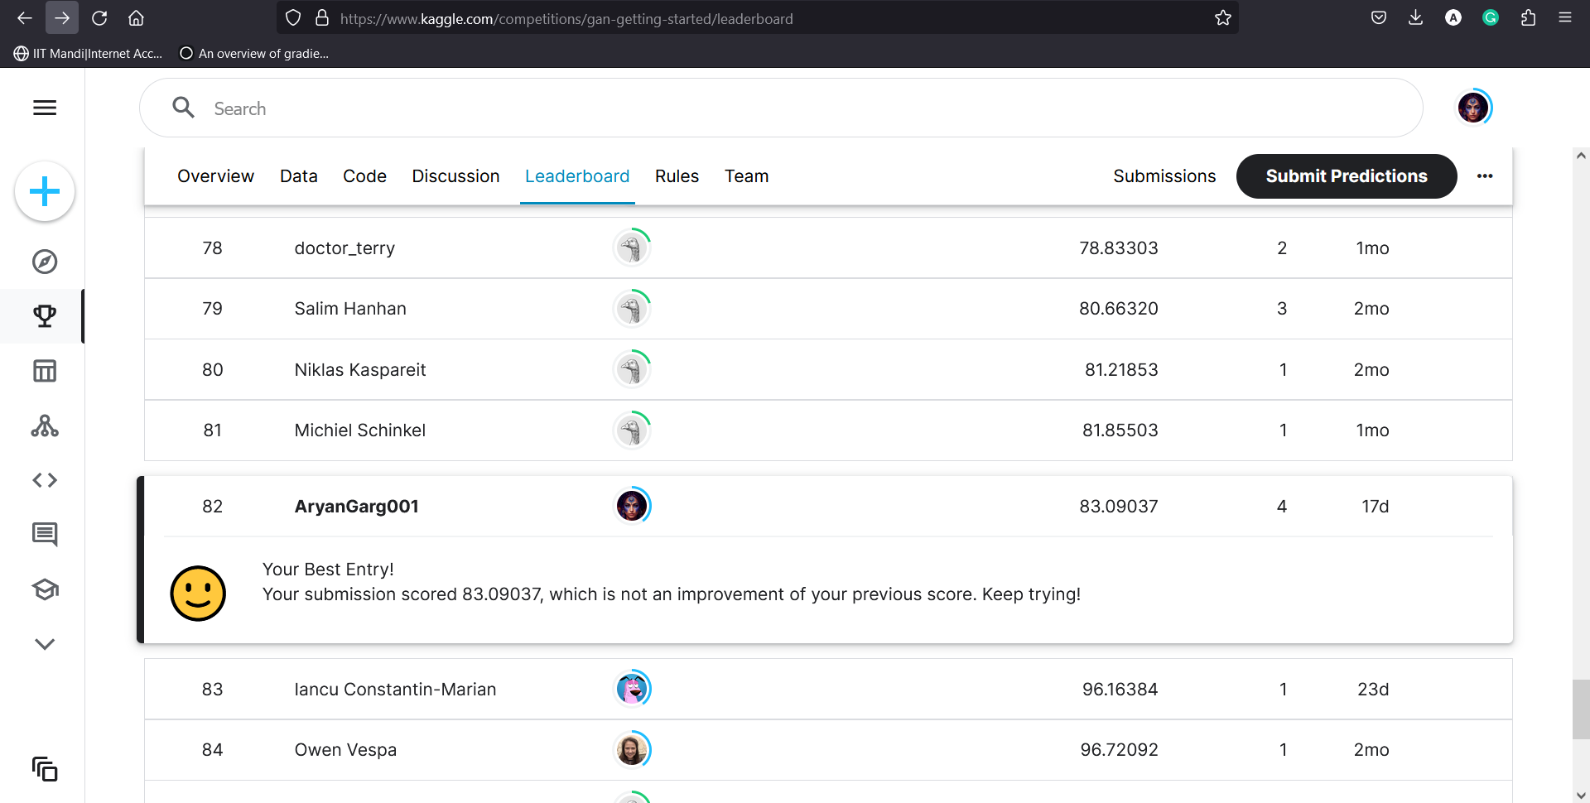
cycleGAN: Monet like Style Transfer
Effectively: y → F(y) → G(F(y)) ~= y
This is enforced with an additional cycle consistency/enforcing loss term:
Rank: 82 in style-transfer competition on Kaggle: [Mi-FID Score: 83.09037]

Slide 19
Pix2pix
Conditional GAN (input: semantic segmentation/label-map)
The architectures employed for the generator and discriminator closely follow DCGAN, with a few modifications:
Concatenated skip connections: similar to a U-Net.
PatchGAN discriminator: Only penalizes structure at patch scale.
Progression: pix2pix → pix2pixHD → SPADE
(MITACS Research Internship work on SPADE: Upgraded to HDR outputs for largest HDR dataset in the world: Laval HDR SkyDB (~34,000). Also segmented the dataset → 2 posters; 2 papers published!)

Slide 20
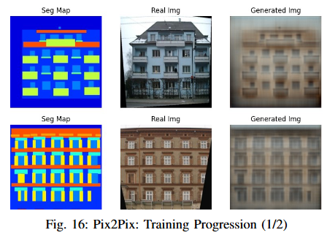
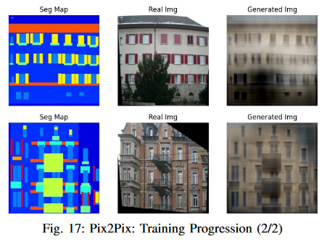
Pix2pix - Results on Facades

Slide 21
Thank you
Questions?

